Slide 1
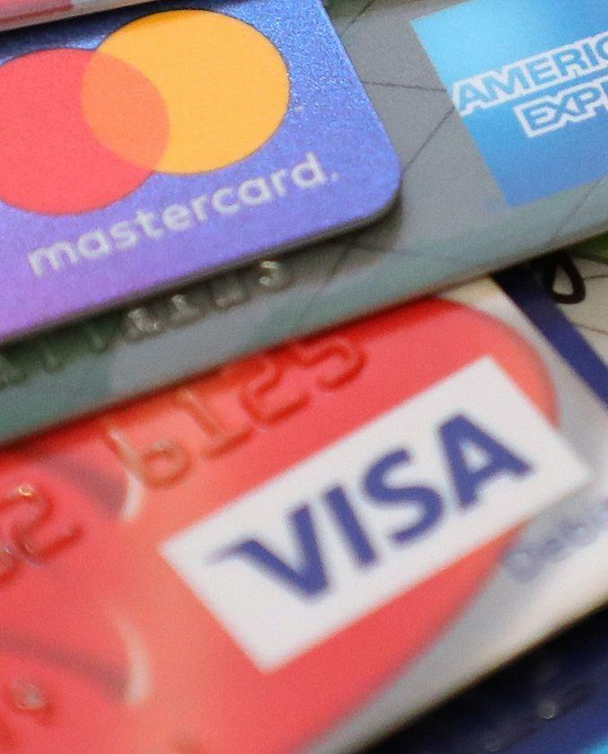
Sprint 3
Calibrated Techniques: Ways to Improve Fraud Detection Systems
Team Patrick
Shawn | Marco | Avie | Bevs
Notes:
Prompts:
What is your hypothesis around why the CEO’s transaction was rejected and classed as fraud?
What are examples of anomalous transactions which may look suspicious? When might these be genuine?
What data could be collected from the customer in order to help the model make better, more informed predictions?
What recommendations would you make?

Slide 2
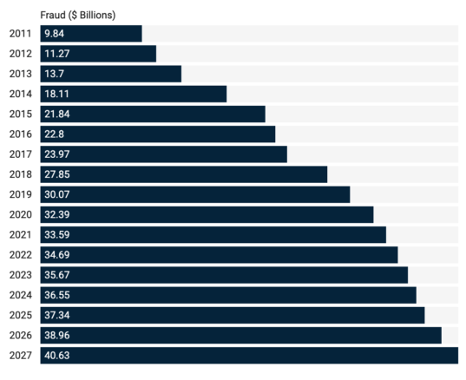
Credit Card Fraud
Fraud committed using a credit card or any similar form of payment mechanism
The purpose is to obtain unauthorized funds from the credit cardholder’s account
Philippine Outlook
Global Outlook
25% of complaints received were related to credit cards
March -May 2020
98.4% of criminal incidents reported were cyber or online in nature
Losses equivalent to 60.6 M or 54.5% of all total bank losses
Source: Merchant Savy UK, 2020
Introduction
Notes:
Background (External research) - establish problem statement: why do we need a fraud detection system?
Global outlook: amount of losses due to fraud
Fraud statistics in PH

Slide 3
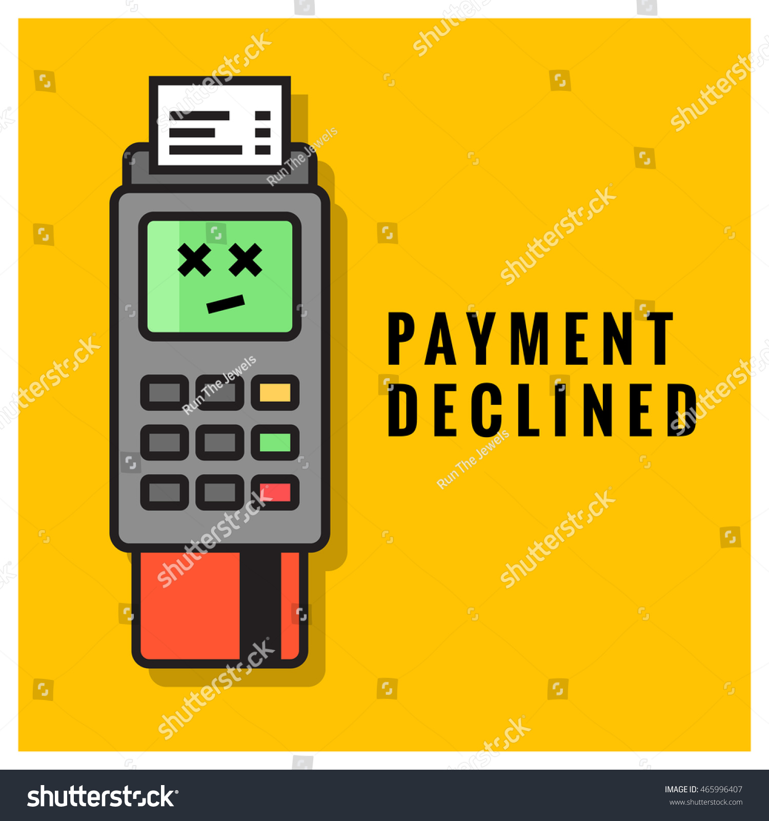
Problem Overview
Fraud Detection System
Tags fraudulent transactions
Automatic process
Case study:
CEO’s card was blocked
CEO was on travel
Introduction
Notes:
Team Patrick Scenario:
Your model went into production with the setting of automatically rejecting fraudulent transactions, but unfortunately it blocked the CEO’s credit card when she went travelling for a snap business meeting and couldn’t check into her hotel! She is furious and has asked for an immediate report on what happened. Fortunately her chief of staff has a much cooler head, and sees this as an opportunity.
The chief of staff realises that if it could happen to the CEO it may also be an experience our other customers might experience, and if we can bring together a number of different Agile Tribe leads together we could design a better solution.

Slide 4
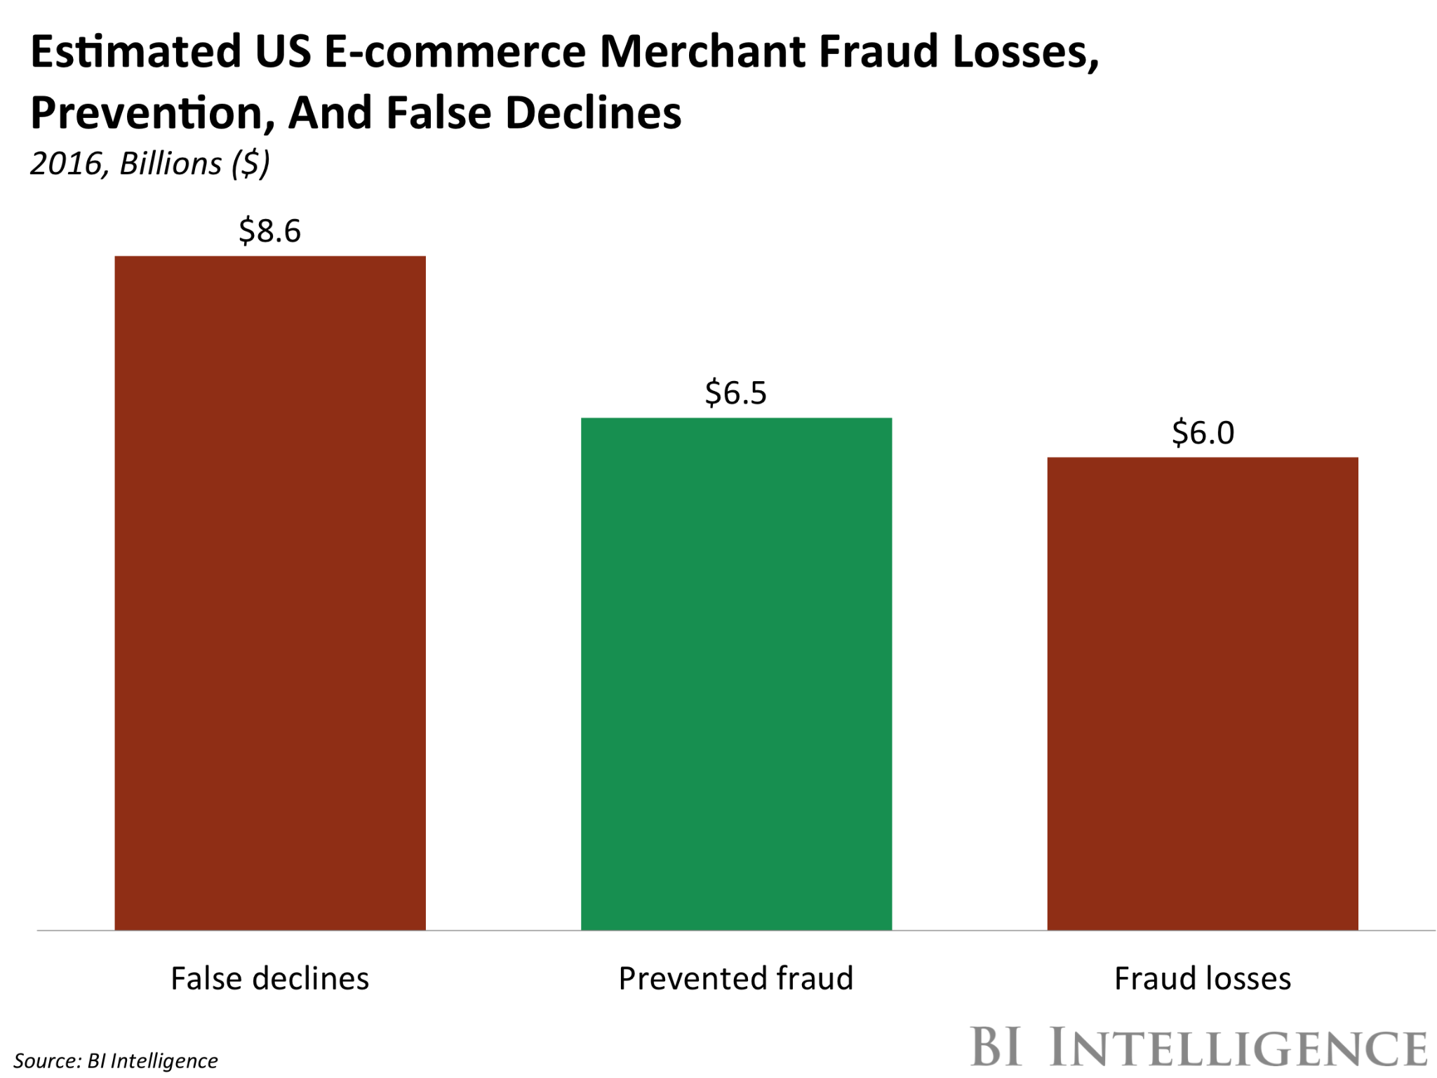
The Case of False Positives
Long term financial impact of false positives:
Immediate revenue loss
Lost customer lifetime value
Wasted acquisition spend
Degraded brand image
Occurs when merchants or financial institutions decline legitimate orders
Introduction
Notes:
These false declines are becoming a costlier problem than actual fraud. Looking at US data, e-commerce merchants will lose $8.6 billion in falsely declined transactions in 2016, according to our estimates. This amounts to over $2 billion more than the $6.5 billion in fraud they will prevent, meaning that false declines are undermining these merchants' ability to effectively combat fraud.
***
Immediate revenue loss. Every order wrongly turned down is revenue not realized.
Lost customer lifetime value. Lifetime customer value is the total profit anticipated from all future purchases by a customer. Legitimate customers who are wrongly rejected will often stop buying from that merchant permanently.
Wasted acquisition spend. Acquisition spend refers to all the costs associated with convincing a consumer to place an order (e.g., research, marketing, and advertising). If you spend $10 to convince a customer to buy but mistakenly decline their order (i.e., false positive), you’ve wasted that $10 acquisition cost on top of the lost revenue.
Degraded brand image. In today’s connected world of social media and viral posts, one shopper’s experience with a false positive can suddenly reach thousands and thousands of customers and potential customers. While difficult to quantify, the impact of negative publicity is nonetheless real.

Slide 5
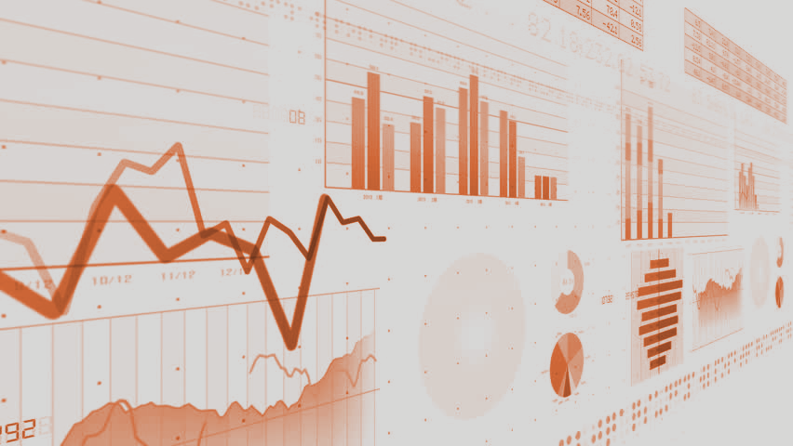
Objectives
Review current fraud detection system
Recommend ways to make the system better
Introduction

Slide 6
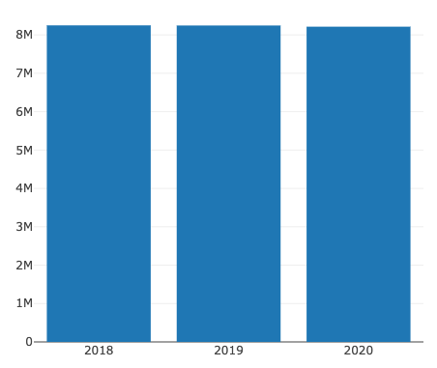
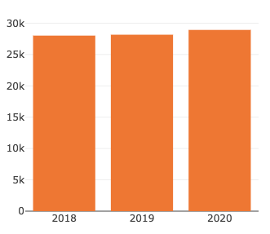
Overview of
Fraudulent Transactions
For the last 3 years:
gradual decrease in total credit card transactions
gradual increase in fraudulent transactions
82.49 M
82.46 M
82.14 M
28,020
28,165
28,927
Total credit card transactions (2018-2020)
Fraudulent transactions (2018-2020)
Fraud Behavior Analysis
Notes:
Characteristics of fraudulent transactions
Fraudulent transactions per year -increasing/decreasing? (chart)
How is this compared to the trend of total credit card transactions? (chart)

Slide 7
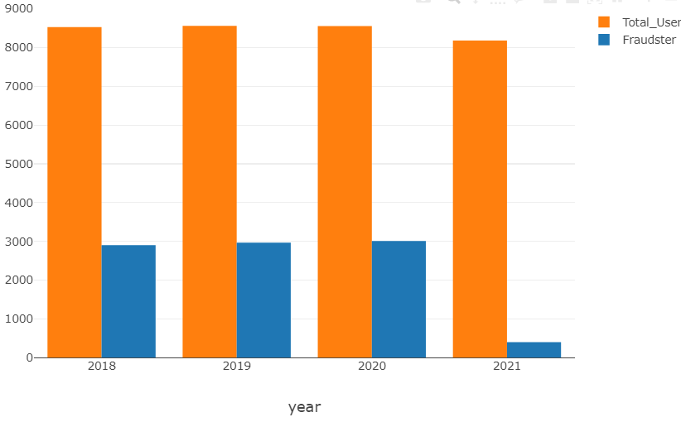
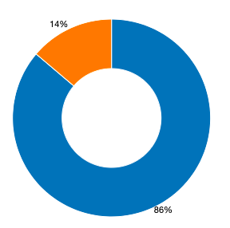
Overview of
Fraudulent Transactions
For the last 3 years, ~35% of total users experience fraud annually
~14% of the most recent user transactions are fraudulent
Fraud
Fraud
34.67%
35.19%
34.08%
Not Fraud
Non-fraud
Fraud Behavior Analysis
Notes:
Characteristics of fraudulent transactions
Per year customers experiencing fraud
Most recent transactions

Slide 8








Client Profile data
ssn | credit card number | account number | name |
sex | address | profession | birthdate
Spending Behavior data
transaction number | transaction date and time | product category | amount |
merchant | merchant location
Amount
Geospatial Occurrence
Merchants
Product Category
Time Period
Fraud Behavior Analysis

Slide 9
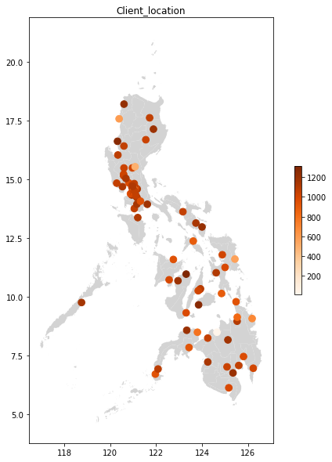
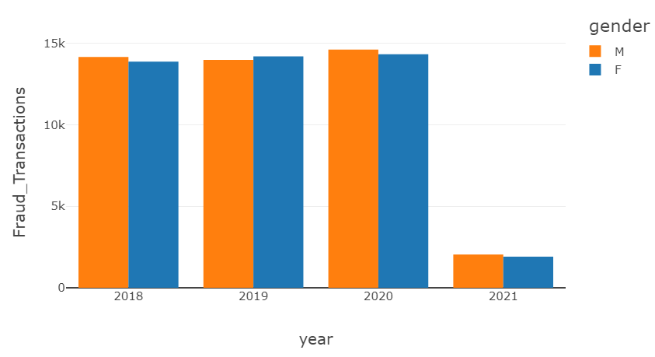
Fraudulent Transactions:
Client Profile (Sex, Address)
Overview of Credit Card Fraud Transactions
Fraud Behavior Analysis
Notes:
Profile of clients affected by fraudulent transactions
Sex comparison
Age histogram

Slide 10
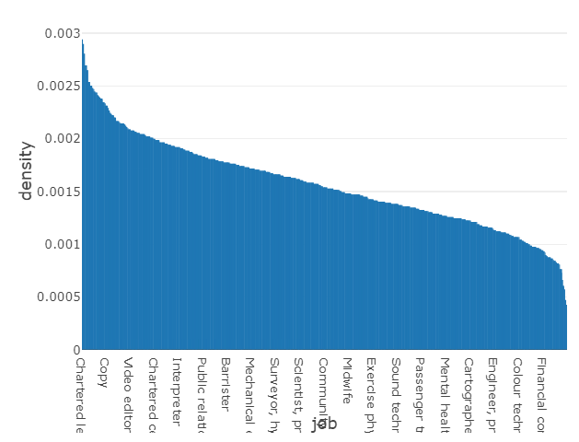
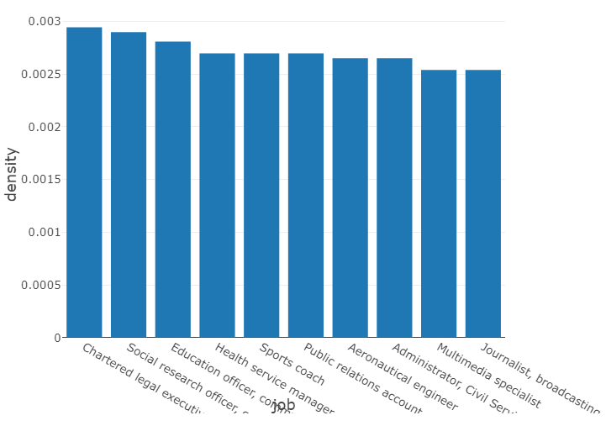
Overview of Credit Card Fraud Transactions
Fraudulent Transactions:
Client Profile (Job)
Fraud Behavior Analysis
Notes:
Profile of clients affected by fraudulent transactions
Sex comparison
Age histogram

Slide 11
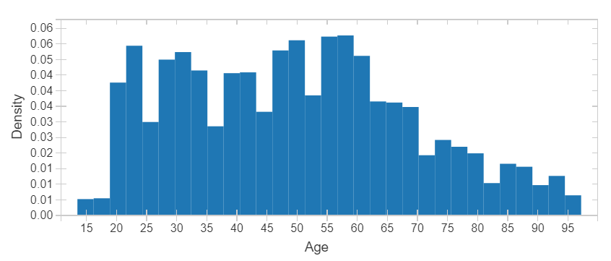
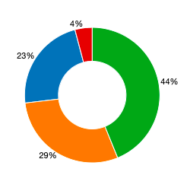

Overview of Credit Card Fraud Transactions
Fraudulent Transactions:
Client Profile (Age)
Fraud Behavior Analysis
Notes:
Profile of clients affected by fraudulent transactions
Sex comparison
Age histogram

Slide 12
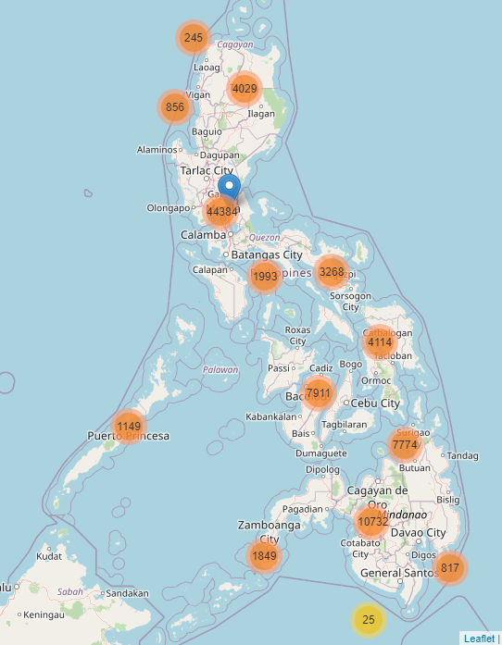
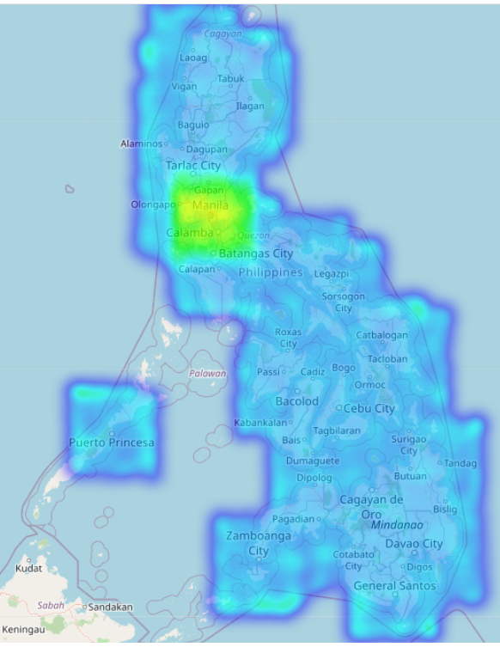
Overview of Credit Card Fraud Transactions
Fraudulent Transactions:
Geospatial Occurrence
Fraud transactions mostly occurs on NCR Area and nearby provinces
Fraud Behavior Analysis
Notes:
Profile of clients affected by fraudulent transactions
Heat map of client’s location
Heat map of fraud occurrence

Slide 13
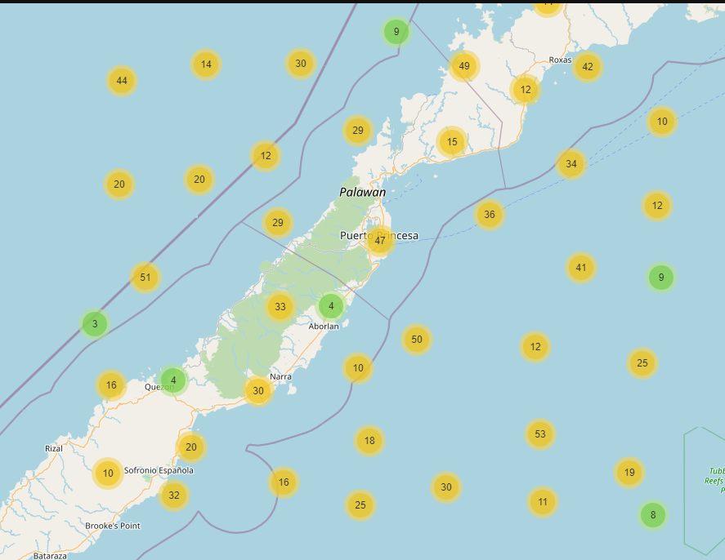
Overview of Credit Card Fraud Transactions
Fraudulent Transactions:
Geospatial Occurrence
Fraud transactions mostly occurs on NCR Area and nearby provinces
However, geospatial points are inaccurate. Many locations are outside land areas
Fraud Behavior Analysis
Notes:
Profile of clients affected by fraudulent transactions
Heat map of client’s location
Heat map of fraud occurrence

Slide 14
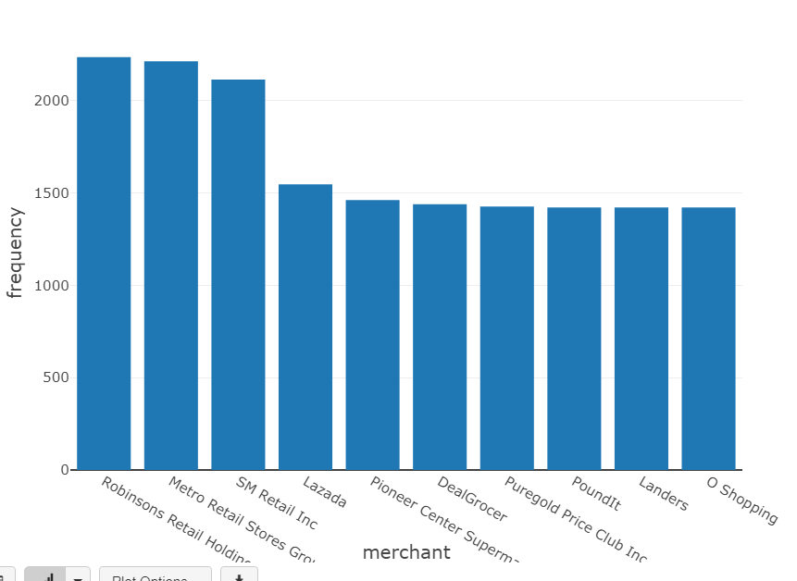
Fraudulent Transactions:
Most Common Merchants
Robinsons, Metro Retail Stores Groceries, and SM Retail Inc. are merchants with the highest occurrence of fraud
Fraud Behavior Analysis
Notes:
Note na mas naconsider ang merchant categories vs merchants haha

Slide 15
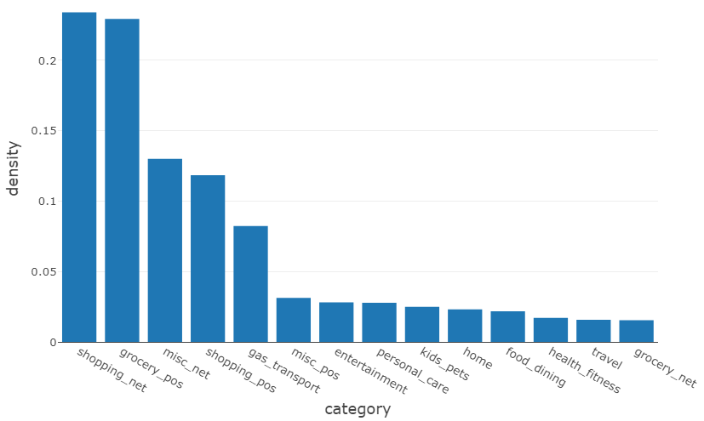
Fraudulent Transactions:
Product Category
~80% of total fraud transactions came from the following categories
Online Shopping (23.4%)
Groceries (22.9%)
Misc. Online Transactions (13%)
Shopping (11.8%)
Gas and Transport (8.2%)
Fraud Behavior Analysis
Notes:
Product category of fraudulent transactions (chart)

Slide 16
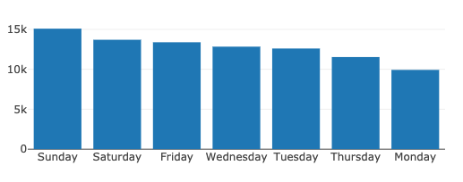
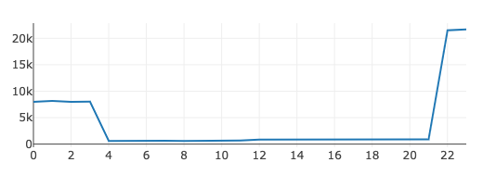
Fraudulent Transactions: Time Period of Occurrence
Fraudulent transactions occur most often during the weekend (Friday-Sun) and at 10PM - 3AM
Total number of fraudulent transactions per day of the week
Total number of fraudulent transactions per hour
Fraud Behavior Analysis
Notes:
Time period when most fraudulent transactions occur
Days of the week (chart)
Time of the day (chart)

Slide 17
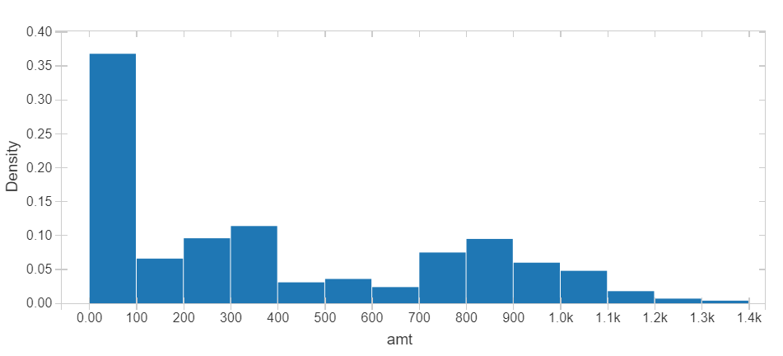
Fraudulent Transactions:
Most Common Amount
Majority of fraudulent transactions costs PHP 100 or less
Fraud Behavior Analysis
Notes:
Revise ko lang yung bins

Slide 18
Common Features of
Fraudulent Transactions
Time Occurence
10PM-3AM
Day Occurrence
Friday to Sunday
Transaction Amount
PHP 100.00 and below
Product Category
Online Shopping, Groceries,
Online Transactions, Shopping,
Gas and Transport
Fraud Behavior Analysis

Slide 19
Fraud Detection System Version 1.0
Machine Learning Pipeline (PySpark)
Data preprocessing
Feature processing
Model training
& tuning
Model prediction
Model evaluation
Train
+
Test
StringIndexer
VectorAssembler
RandomForest
Classifier
GBT Classifier
XGBoost
Confusion matrix
Undersampling
Train
Test
Fraud Detection System

Slide 20
Fraud Detection System Version 1.0 Performance
Accuracy:
How many Fraud and Legitimate Transactions were predicted accurately out of total transactions
Precision:
How many of those predicted as Legitimate are actually Legitimate
*single class metric
Recall:
How many Fraud cases are accurately identified as Fraud
*single class metric
Fraud Detection System
Notes:
Characteristics of data set: Unbalanced + how this was resolved
Accuracy %: Fraud + Legitimate Transactions

Slide 21
Fraud Detection System Version 1.0
GBTClassifier: XGBoost
Random Forest Classifier
 | Precision | Recall
Non-fraud | 97% | 97%
Fraud | 97% | 97%
 | Precision | Recall
Non-fraud | 94% | 97%
Fraud | 96% | 94%
Fraud Detection System
Notes:
Characteristics of data set: Unbalanced + how this was resolved

Slide 22
Fraud Detection System Version 1.0
GBTClassifier: XGBoost
Feature Importance
Confusion Matrix
Amount | 0.6518 | Age | 0.0039
Time | 0.1489 | Gender | 0.0019
Merchant | 0.1192 | Merchant Distance | 0.0
Category | 0.0742 | Day of the Week | 0.0
TP: 17284 | FP: 474
FN: 470 | TN: 17368
Fraud Detection System

Slide 23
Fraud Detection System Version 2.0
Conclusion
False positives must be reduced in order for fraud detection mechanisms to be cost effective
Issues with false-positives can be summarized into 3 categories:
Identity-related
Technical
Structural
Consumer spending behavior VARY GREATLY
Feature engineering is (almost) everything
Need for a better model that can provide a deeper analysis of spending behavior
Conclusion and Recommendations

Slide 24
Fraud Detection System Version 2.0
Recommendations
Identity-related (historical data + transaction data)
biometrics, IP address, conflicting billing + shipping information, updated card information…
Technical (bank)
local domains, smart routing
Structural (Version 2.0):
Increase processing power for further hyperparameter tuning
Extract better features
Increase number of features
Consistent updating and review
Conclusion and Recommendations

